Slide 1

Major Project
Smart Plug and Socket System.
Presented by :-
Sr.No | Name | IDNo.
1 | Abhishek Jagtap | VU4F2324131
2 | Affan Shaikh | VU4F2324135
3 | Suraj Yadav | VU4F2324136
4 | Aditya Gupta | VU4F2324151
Under the Guidance of
Prof. Neeta Ingale
Department of Information Technology
AY : 2026-27

Slide 2
Smart socket and plug system.
“Transforming traditional electrical systems into intelligent, connected, and energy-efficient smart environments.”

Slide 3
Project Overview
Content:
IoT-based system to monitor and control electrical appliances
Tracks: Voltage, Current, Power, Energy
Controls: Fans, lights, sockets via mobile/web
Uses: ESP32 + Relay + Energy Meter (PZEM)
“Our goal is to convert this into a scalable smart energy product.”

Slide 4
Problem Statement & Motivation
Traditional electrical systems in homes, college labs, and small offices operate as passive systems. Users can switch appliances ON/OFF manually, but they generally cannot monitor real-time voltage, current, power consumption, or energy usage per appliance, nor can they control devices remotely from a centralized platform. This leads to:
Energy wastage when fans, chargers, lights, and appliances are left ON unnecessarily
No real-time monitoring of power usage or overload conditions
Lack of appliance-level analytics for understanding consumption patterns
No remote access or automation, especially useful for labs, hostels, and homes
Limited awareness of electricity usage and cost-saving opportunities

Slide 5
Motivation
The motivation behind this project is to transform a normal socket/plug into a smart, connected, energy-aware device that can:
monitor power usage in real time
remotely control connected appliances
improve safety and convenience
reduce electricity wastage
serve as a low-cost smart energy management solution for Indian homes, colleges, and offices

Slide 6
SDG Mapping
SDG 7 – Affordable and Clean Energy
The project helps in efficient energy utilization by monitoring electricity usage in real time and reducing unnecessary power consumption through smart appliance control.
SDG 9 – Industry, Innovation and Infrastructure
The proposed system uses IoT-based smart infrastructure to convert conventional electrical sockets into intelligent, connected, and scalable energy management units.
SDG 12 – Responsible Consumption and Production
By enabling users to track and control appliance-level power usage, the project promotes responsible electricity consumption and energy-saving behavior.

Slide 7
Literature Survey :-
Sr. No. | Reference Paper | Objective / Contribution | Limitations Identified | Gap Addressed in Our Project
1 | M. Rokonuzzaman (2021), “Design and Implementation of an IoT-Enabled Smart Plug Socket for Home Energy Management,” IEEE ICSGSC | Proposed an IoT-enabled smart plug socket for monitoring and controlling energy usage with smartphone/web integration | Primarily focused on home energy management; limited emphasis on scalable multi-device smart energy platform | Our project focuses on a low-cost scalable smart socket system with monitoring, control, and future analytics/automation
2 | Y.-B. Lin (2018), “Mor Socket: An Expandable IoT-Based Smart Socket System,” IEEE Access | Developed an expandable IoT-based smart socket system for remote appliance control | Expandability is addressed, but appliance-level energy analytics and low-cost educational deployment are not the main focus | Our system emphasizes Voltage, Current, Power, and Energy monitoring along with practical low-cost deployment
3 | K.-L. Tsai (2016), “Residence Energy Control System Based on Wireless Smart Socket and IoT,” IEEE Access | Presented a wireless smart socket system for residential energy control and energy saving | Mainly targeted residential energy control; limited focus on future AI-based energy optimization | Our project extends toward future AI-based automation, analytics, and broader use in homes/labs/offices
4 | E. A. Yeboah (2026), “Development of an IoT-enabled smart plug for intelligent energy monitoring in household appliances” | Developed an IoT smart plug for intelligent energy monitoring of household appliances | Strong monitoring focus, but remote control and product-oriented multi-use deployment can be extended further | Our project combines energy monitoring + remote appliance control + future smart energy management features

Slide 8
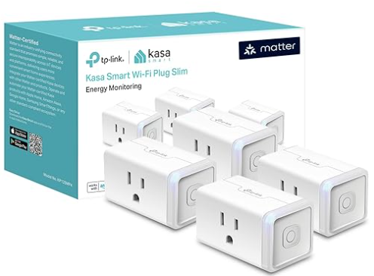
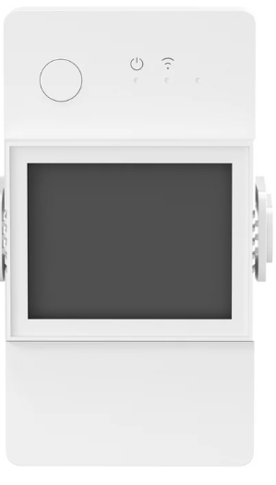
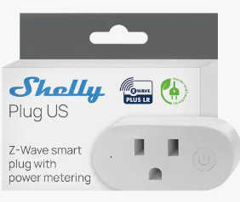
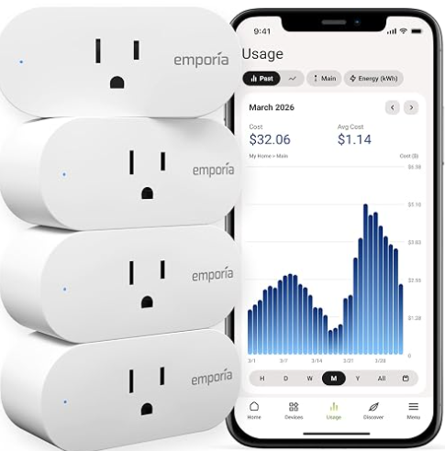
Product Name | Product Image | Product Specification | Gap vs Our Project | Cost
TP-Link Kasa Smart Plug (HS110 / KP125M / EP25P4) |  | Wi-Fi plug with real-time + historical energy monitoring, scheduling, away mode, voice control (Alexa/Google/Siri), Matter support. | Closed ecosystem (Kasa app only), no open dashboard/analytics customization, not India-priced/low-cost, no lab/multi-device educational focus. | Rs. 4290/-
Sonoff POW Origin / POW Elite / POWR316D (ITEAD) |  | ESP32/ESP8266-based smart switch with LCD display showing real-time V/I/P and 6-month hourly consumption history, overload protection, exportable data, Home Assistant/eWeLink integration. | Single-appliance focus, no centralized multi-appliance dashboard, relies on third-party cloud (eWeLink), limited to power monitoring rather than an integrated automation/analytics platform. | Rs. 1700/-
Shelly Plug S / Plus Plug S (Shelly, EU) |  | Compact Wi-Fi smart plug with power monitoring, temperature-safety cutoff, local API access, ESPHome/Home Assistant compatible. | Premium pricing, not optimized for Indian voltage/appliance ecosystem, no built-in appliance-level analytics dashboard for institutions. | Rs. 3345/-
Wipro Wi-Fi Smart Plug (10A/16A) with Energy Monitoring |  | India-market smart plug, app-based (Wipro Next), remote on/off, scheduling, energy monitoring, Alexa/Google Assistant support — targeted at Indian appliances (geysers, ACs, TVs). | Consumer-only (no lab/institutional deployment model), closed proprietary app, no analytics/AI roadmap, single-device granularity only. | Rs. 3169/-

Slide 9
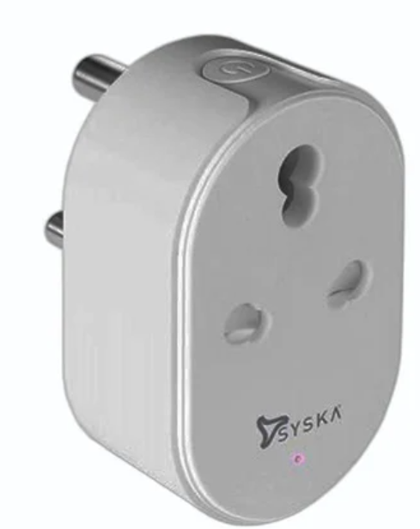
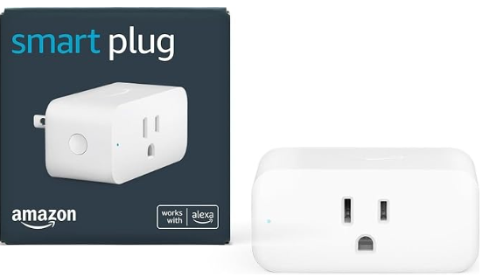
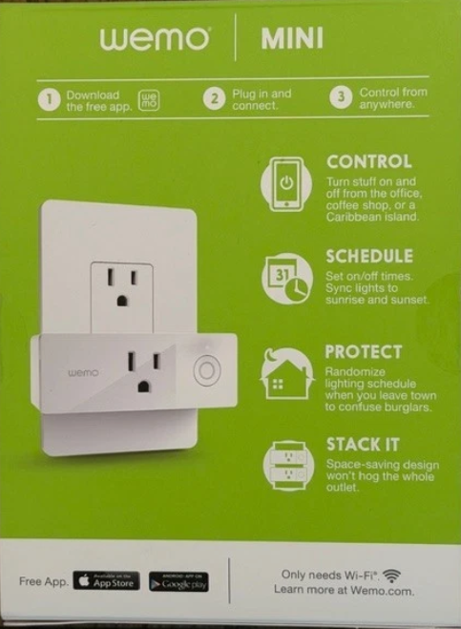
Product Name | Product Image | Product Specification | Gap vs Our Project | Cost
Syska / Havells / Zebronics Smart Plugs (India) |  | Budget Indian smart plugs with basic on/off + some with power-meter variants, Alexa/Google integration. | Mostly control-only (no real per-appliance V/I/P/E granularity), no scalability to multi-appliance labs, no future analytics/automation roadmap. | Rs. 850/-
Amazon Smart Plug |  | Simple Alexa-only remote on/off plug, no energy monitoring at all. | No energy metering, no cross-platform (Google/web) support — purely a switch, not an energy-management system. | Rs. 2382/-
Google Nest/Wemo-compatible smart plugs |  | Remote control + basic automation/routines through Google Home/Wemo app ecosystem. | Energy monitoring is limited or absent in most Wemo/Nest-mini plugs; ecosystem lock-in; not designed for institutional/lab energy analytics. | Rs. 1526/-

Slide 10
Objectives
The main objectives of the Smart Socket and Plug System are:
To enable real-time monitoring of voltage, current, power, and energy consumption of connected appliances.
To provide intelligent voice and remote ON/OFF control for convenient and hands-free appliance management.
To analyze energy usage and provide actionable insights to identify wastage and improve energy efficiency.
To develop a secure, scalable, and market-ready smart socket platform with scope for automation and future AI integration.

Slide 11
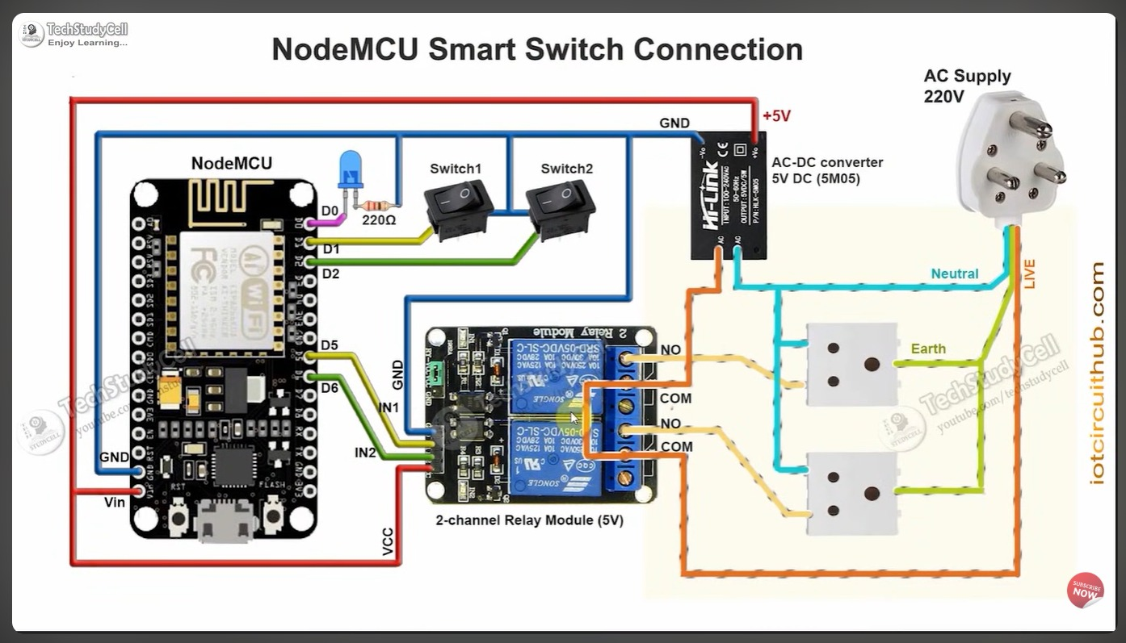
CIRCUIT DIAGRAM

Slide 12
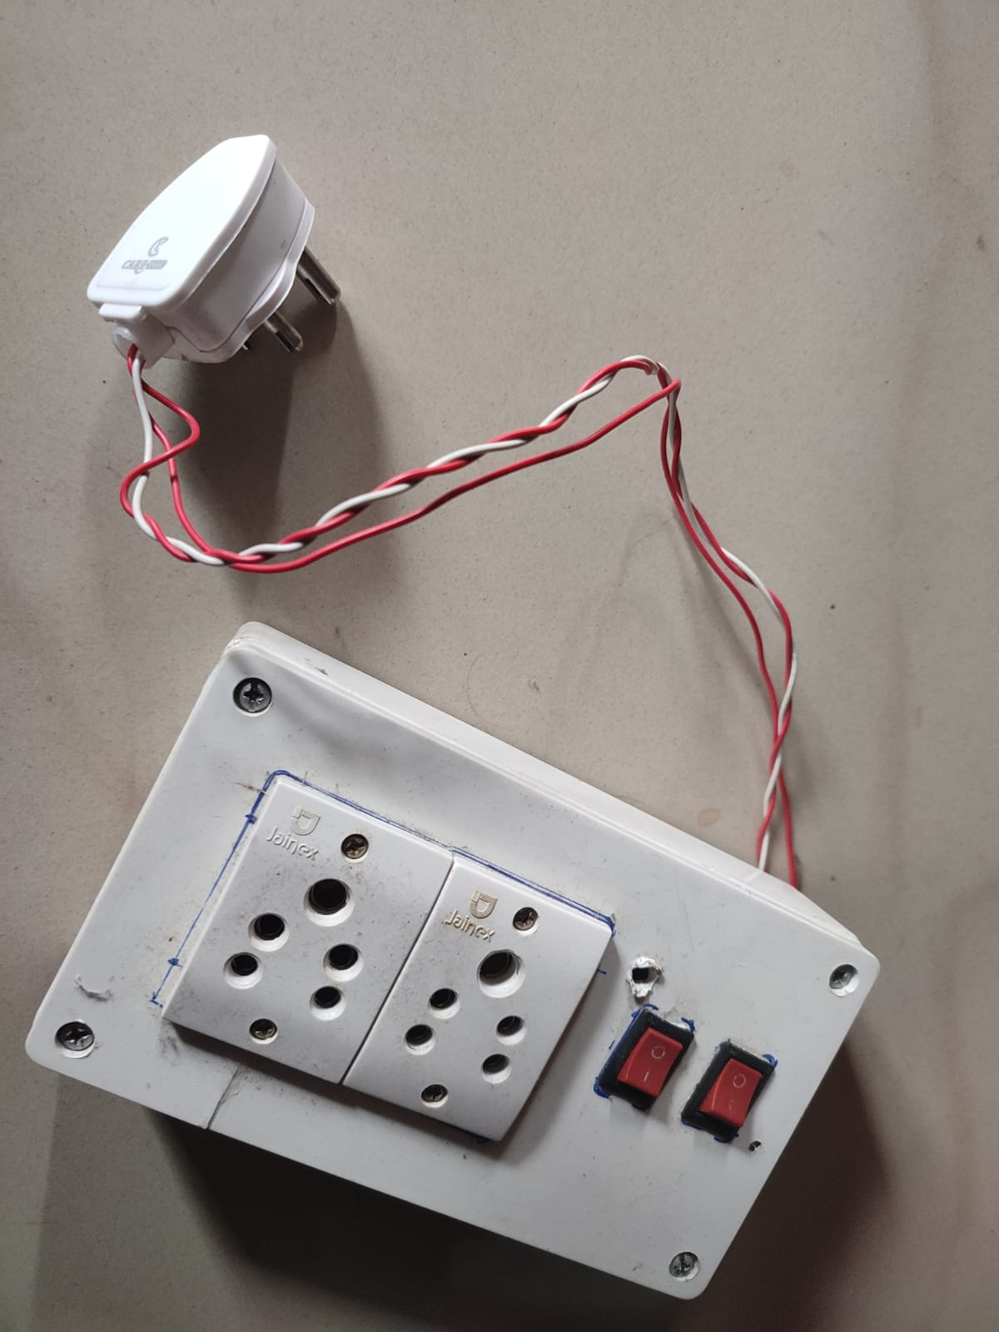
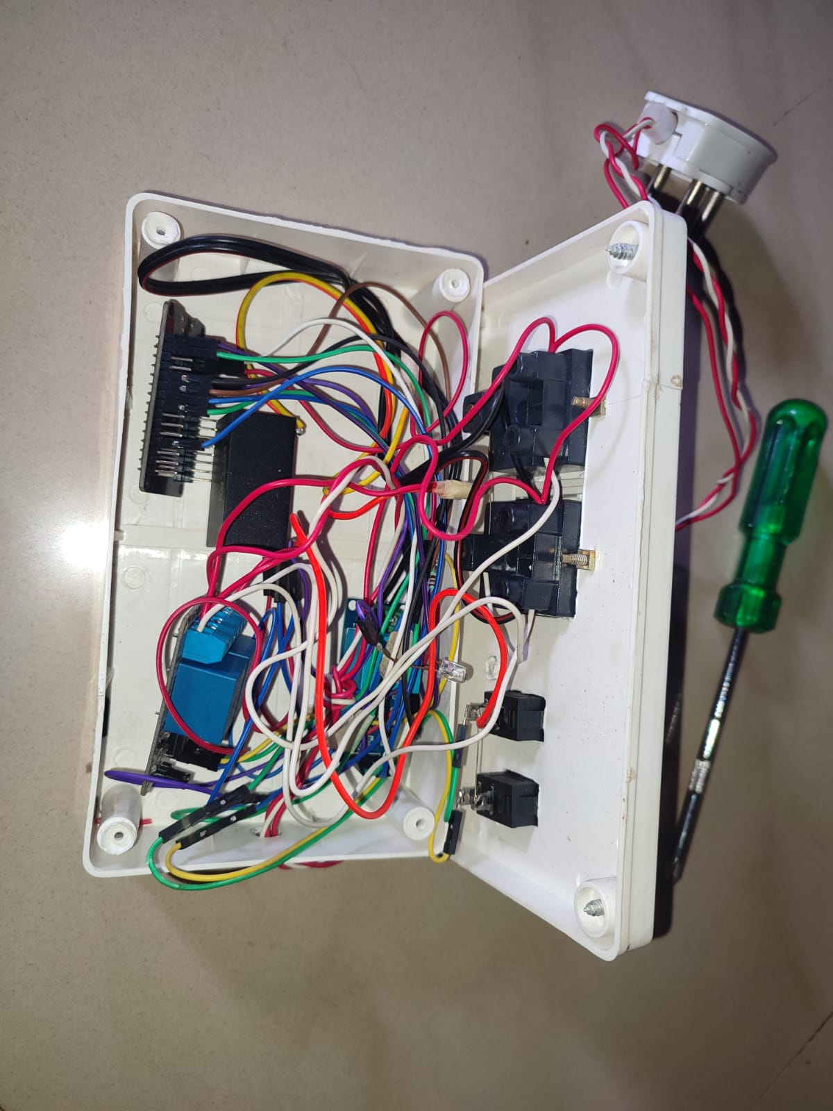
MODEL

Slide 13
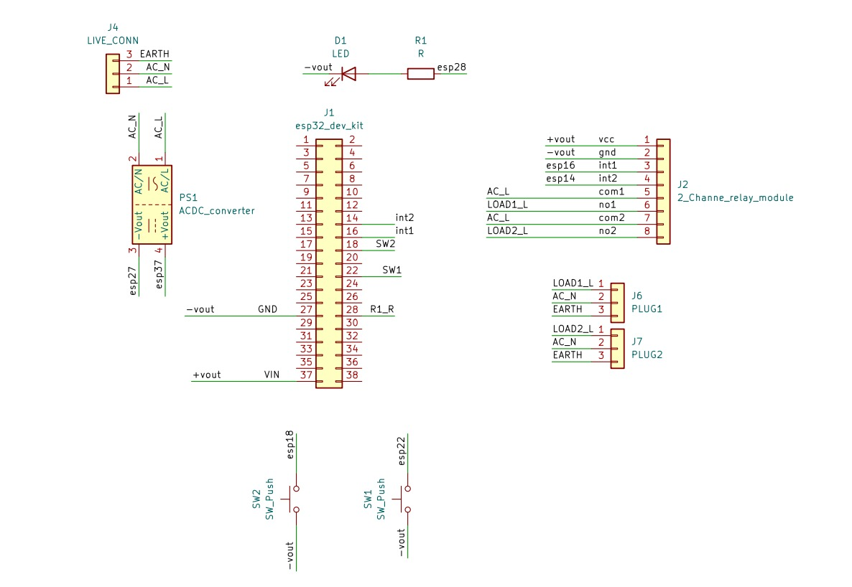
SEMANTIC DIAGRAM

Slide 14
Next Plan :-
Phase 1 (Current → Improve) :-
Stable hardware setup
Multi-device control (10–15 appliances)
Accurate energy monitoring
Phase 2 (Upgrade) :-
Own mobile/web app (instead of Blynk)
Cloud integration (Firebase/MQTT)
User login + dashboard
Phase 3 (Advanced Features) :-
AI-based energy prediction
Auto power saving system
Voice control integration

Slide 15
Product Vision
We aim to build a cost-effective smart energy system for real-world deployment
Target Users:
Homes
Colleges
Offices
Smart buildings
Key Features:
Plug & play smart energy system
Mobile + web control
Energy analytics dashboard
Cost-saving insights
Business Vision:
Convert into IoT startup product
Scalable to smart homes & industries

Slide 16
THANK YOU

